Slide 1

IT Engineering – Intern Summer 2024
Notes:
IT Engineering - Intern

Slide 2


HelLO THERE
I’m Harsha
WAYNE STATE University –
DETROIT
MS – Data Science in Advanced Analytics
Graduated in Fall 2024
Current Role:
IT Intern – Global IT Security Team
Working under dorin, with mentorship from scott and Team

Slide 3





My Journey:
Born, raised, lived, studied, worked in Hyderabad, INDIA.
Moved to USA, Detroit – Master’s, new beginnings
“where it all began.” #HOME
“Where it’s all coming together” #Second home

Slide 4


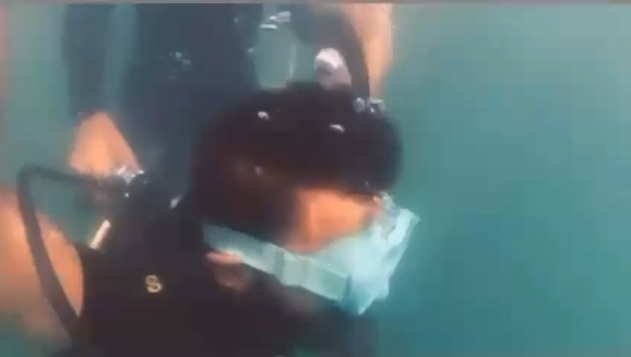
“don’t just analyze — I dive deep, fly high, and jump into every challenge.”

Slide 5
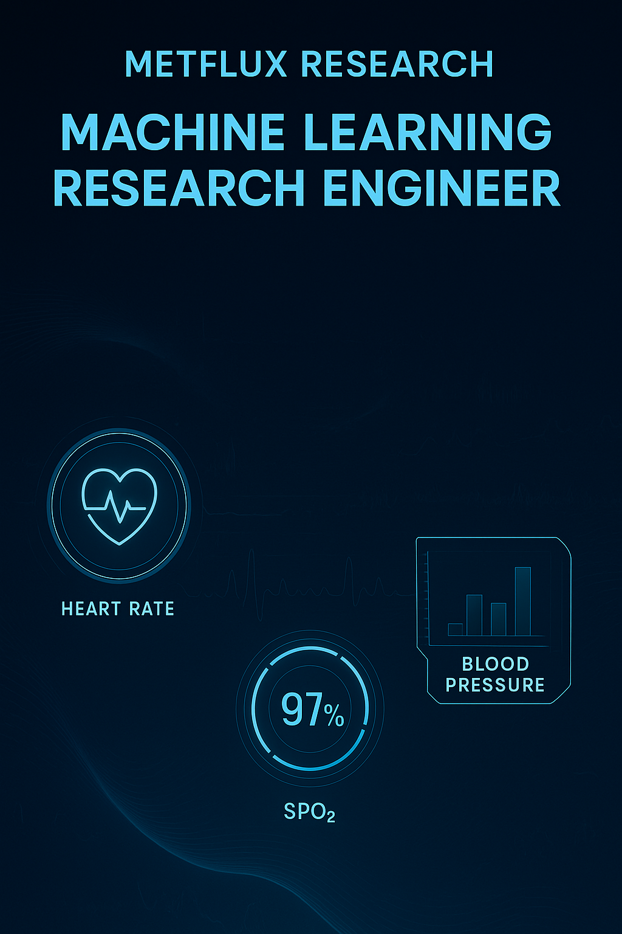
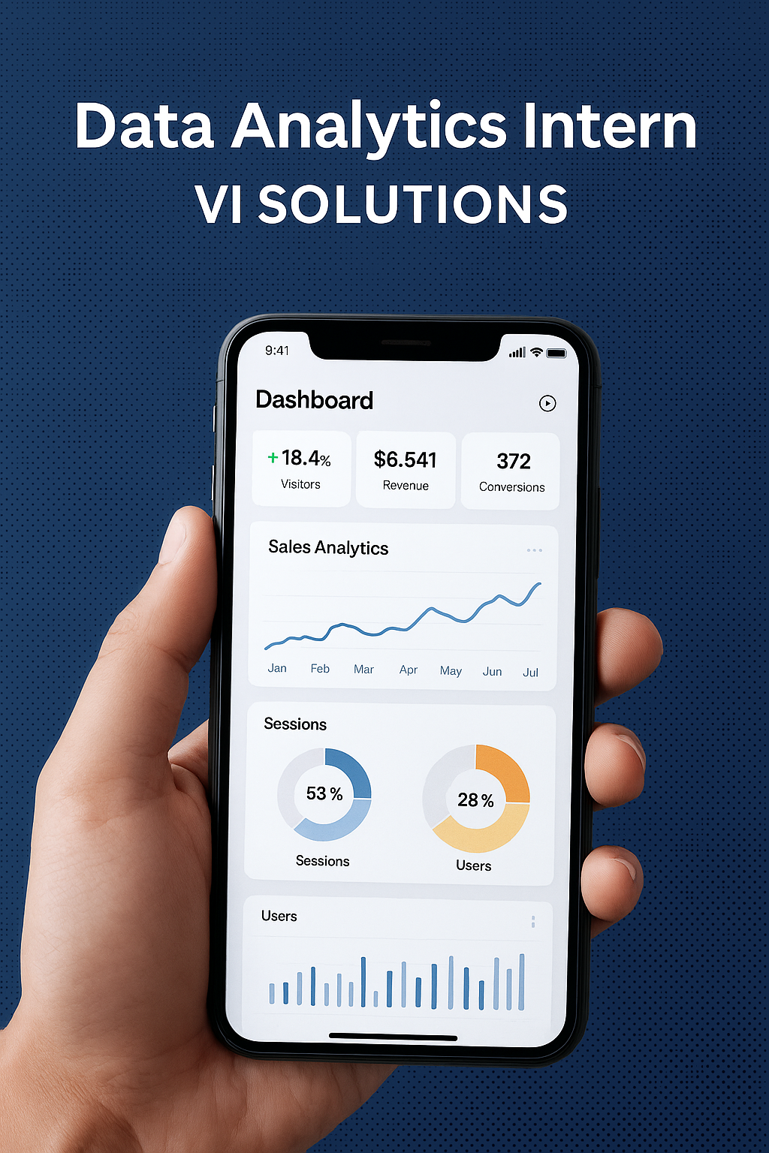


Work Experience

Slide 6
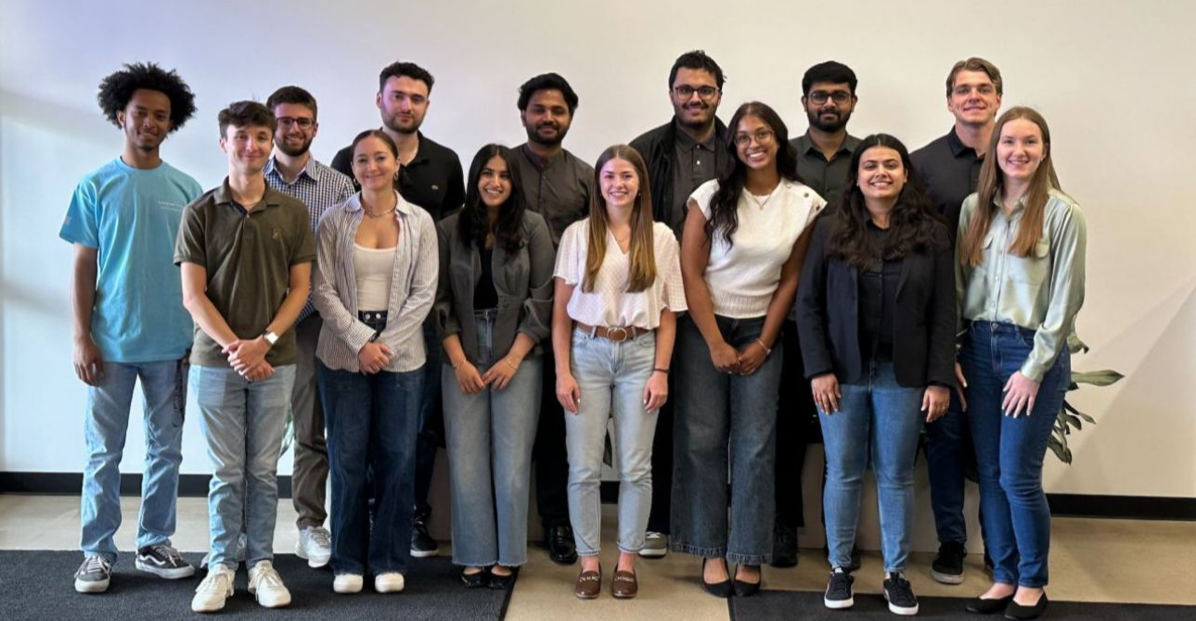
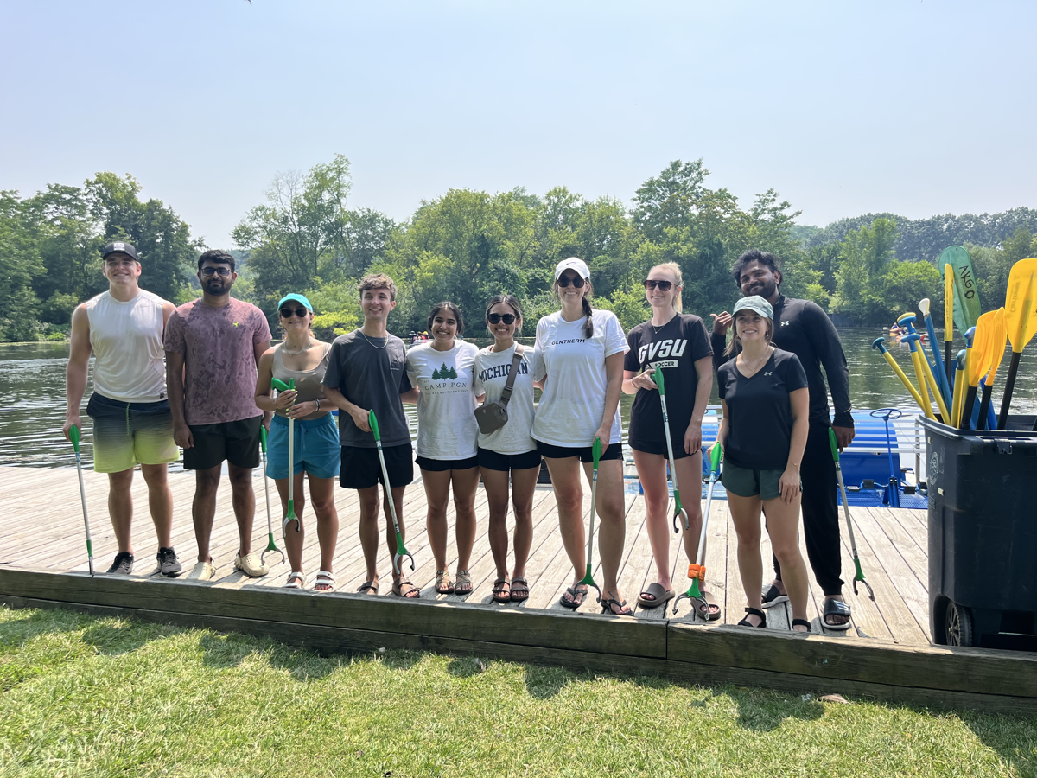
Internship Experience
How Did You Spend Your Summer?
Learning the Gentherm Way
Explored Gentherm’s business strategy and its impact on the automotive industry
Understood how Gentherm’s business and IT work together to deliver in the automotive space
1:1 Mentorship
Grew through weekly mentor check-ins -
focused on technical skills, feedback, and career development
Intern Networking
Built connections with interns across departments
Highlight: Participated in the Gallup River Clean-Up -
and won the challenge with my teammate!

Slide 7

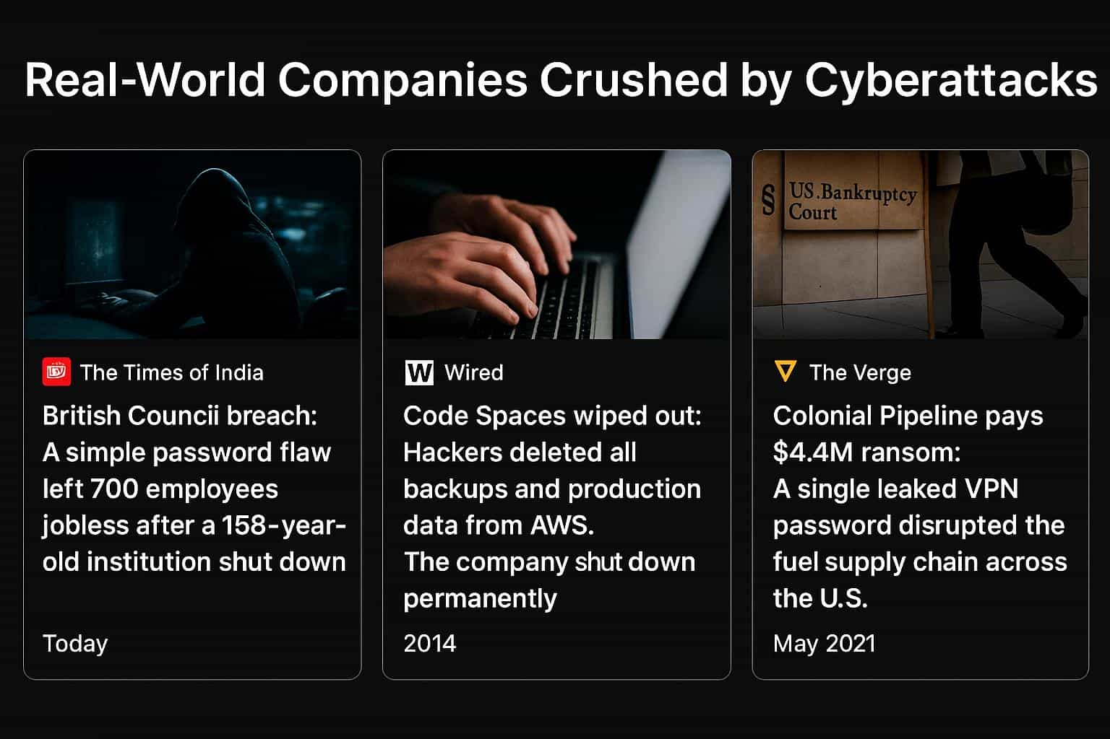
Before starting to my project, it's important to know why the IT Security team exists.
Gentherm is a global organization made up of many departments. From HR to Engineering
Uses digital devices like Laptops, desktops, and more.
These devices are not just tools — they hold valuable data: employee records, product designs, financial reports, factory controls, and more.
That’s why securing every device means securing the organization.
IT Security acts as the wall silently protecting our devices, data and People.
Every Department. Every Device. Every Risk.
“In the last 5 years, over 50 major companies have filed for bankruptcy, lost millions, or shut down due to cyberattacks.”
“If it happened to them, it can happen to anyone.”

Slide 8





IT Security Project Overview

Slide 9
Problem
Challenge:
Our security team protects the organization’s data and infrastructure using a suite of security inventory tools designed to track, monitor, and review assets.
Problem Statement:
Each security inventory tool uses its own logic and structure, with different ways of tracking and securing assets. This led to inconsistent metadata, duplicate entries, and visibility gaps.
Key Question:
How can we help the security team detect visibility gaps instantly using automation and scalable insights?

Slide 10



SOLUTION
Real-Time Asset Visibility Platform
Designed and built a centralized system connecting tools into one unified platform.
Using this, the security team can now instantly answer questions like: ‘Which assets are in X tool but missing from Y tool?’ — all through clear, visual insights instead of fragmented reports.”

Slide 11

MY ACTIONS
Technical Details:
Automated asset ingestion pipelines using Azure Data Factory (ADF) with secure API integrations.
Staged and harmonized data in ADLS Gen2, then enriched it across tools for a single trusted view.
Processed everything at scale inside Databricks notebooks
Structured results stored in both Databricks Lakehouse SQL and Synapse Analytics for scalable querying and reporting.
Delivered insights visually through Power BI dashboards - fast, secure, and actionable.
What It Does: - Helps the security team spot unmanaged or risky assets not visible in key tools. Why is this useful? - Pinpoints high-risk systems early — so the security team can act before they become threats.
- Over 50K+ assets analyzed, 2,300+ visibility gaps surfaced

Slide 12
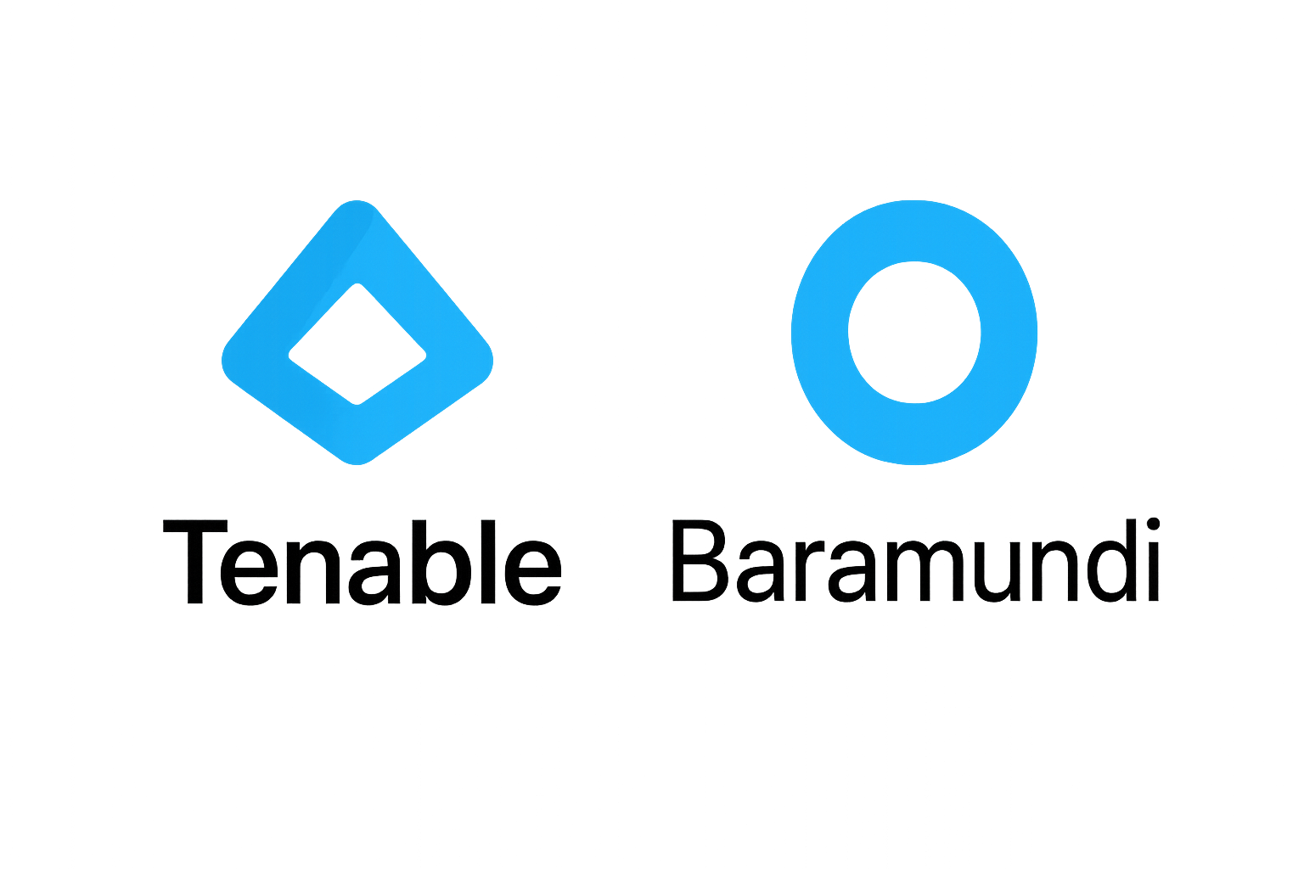



SOLUTION ARCHITECTURE DIAGRAM

Slide 13
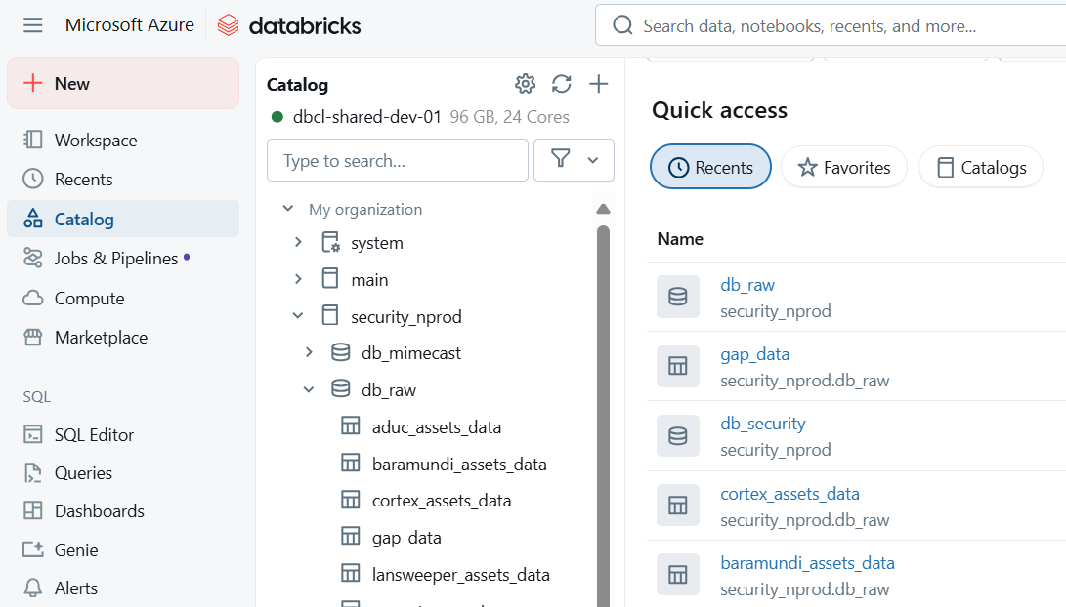
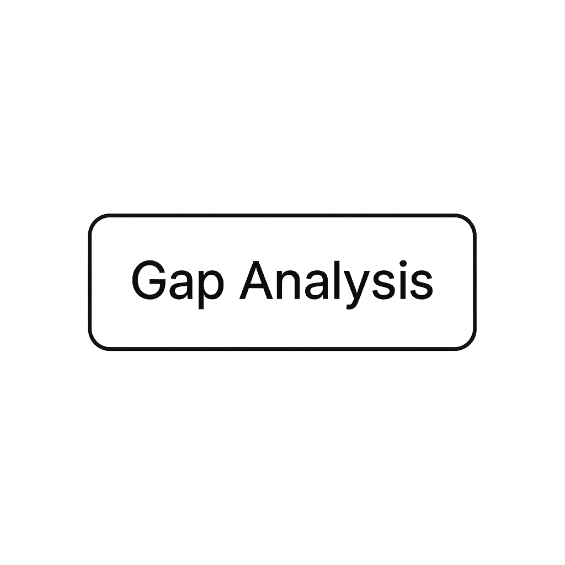



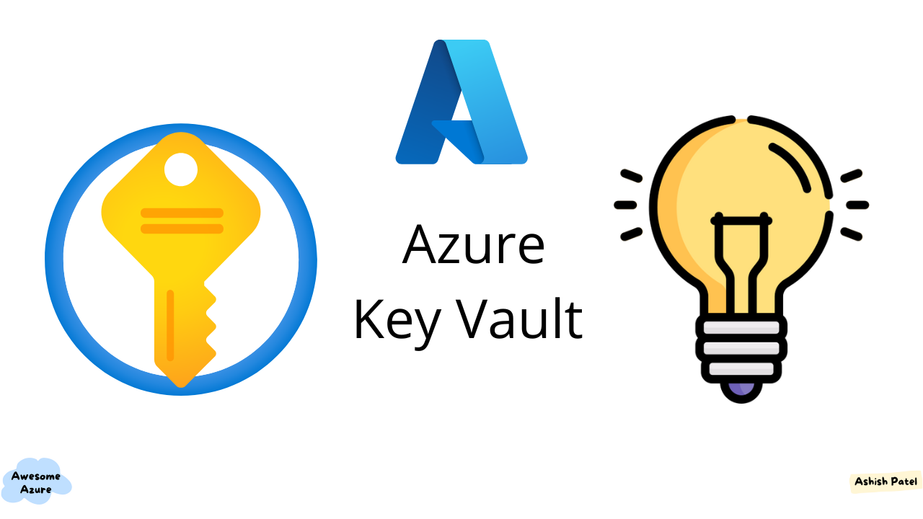
Project Walkthrough
Data Collection to Gap Analysis & Reporting

Slide 14
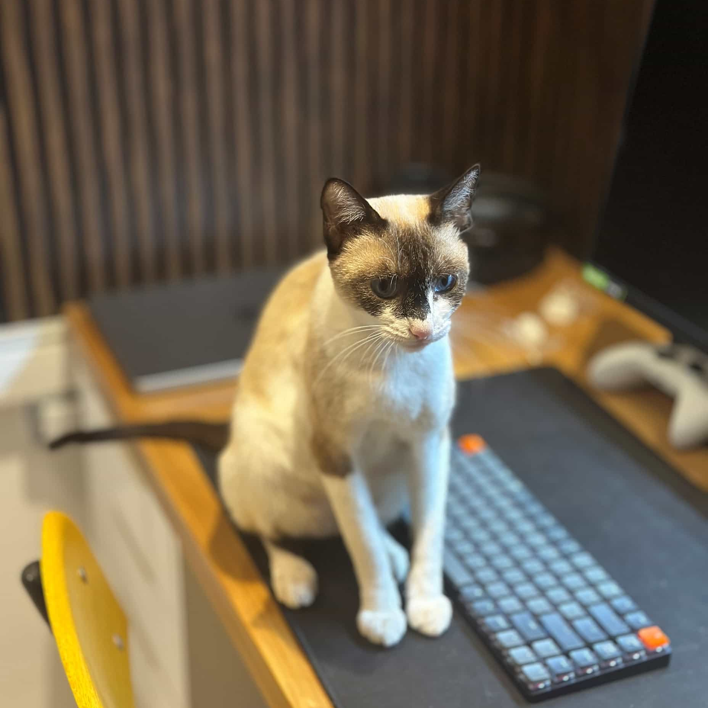
GAP ANALYSIS
Coverage View
2nd Cat
3rd Cat
4th Cat
Covered in Lansweeper
ASSET NAME
ASSET TYPE
Covered in Lansweeper
Covered in Tenable
Covered in Cortex
Covered in Baramundi
Covered in Secureworks
Covered in Active Directory
Status
L26G14KQV3
Laptop
YES
YES
YES
YES
YES
YES
Fully Covered
S29AC01
Server
YES
YES
YES
YES
YES
YES
Fully Covered
YES
W14N138
Workstation
YES
YES
YES
YES
YES
YES
01459
Kat
Cat
Siamese
$ 50,00
8 Days
Pending
Fully Covered
L34N268
Laptop
YES
YES
NO
NO
YES
YES
Partiallly Covered
01459
Kat
Cat
Siamese
$ 50,00
8 Days
Pending
S29DC02
Server
NO
YES
NO
YES
YES
YES
Partiallly Covered
01459
Kat
Cat
Siamese
$ 50,00
8 Days
Pending
W355BK9MN2
Workstation
NO
YES
NO
YES
NO
YES
Partiallly Covered
01459
Kat
Cat
Siamese
$ 50,00
8 Days
Pending

Slide 15

GAP ANALYSIS
Asset Visibility
1st Cat
3rd Cat
4th Cat
Asset name
Asset Type
Region
Site
OS
Cortex Asset Connection
Secureworks Last Seen
Active Directory Last Seen
Baramudi Last Seen
Status
01458
Speedy
Dog
Labrador
$ 50,00
8 Days
Payment
W22VSP2155
WORKSTATION
Asia
Hanam
Windows 10 Enterprise
Connected
2025-07-18
2025-07-18
2025-07-16
Fully Covered
01458
Kat
Cat
Siamese
$ 50,00
8 Days
Pending
L22D5L04M3
LAPTOP
North America
Celeya
Windows 11 pro
Lost
2025-07-16
2025-07-16
2025-07-18
Pending
Fully Covered
Fully Covered
01458
Kat
Cat
Siamese
$ 50,00
8 Days
Pending
L36J1YQQV3
LAPTOP
North America
Northville
Windows 10
Connected
2025-07-16
2025-07-18
2025-07-16
Pending
Partially Covered
01458
Kat
Cat
Siamese
$ 50,00
8 Days
Pending
S35ITACAPP3
SERVER
Asia
Siamese
Windows server 2019
Disconnected
2021-07-16
2021-07-16
2021-07-18
Pending
Fully Covered
Fully Covered
01458
Kat
Cat
Siamese
$ 50,00
8 Days
Pending
L375TLRSV3
LAPTOP
Europe
Siamese
Windows 7
Lost
2025-07-16
2024-07-18
2024-07-14
Pending
Partially Covered
01458
Kat
Cat
Siamese
$ 50,00
8 Days
Pending
DW1424RT
DOMAIN CONTROLLER
North America
Northville
Windows 11
Connected
2025-07-16
2025-07-16
2025-07-16
Pending
Fully Covered

Slide 16
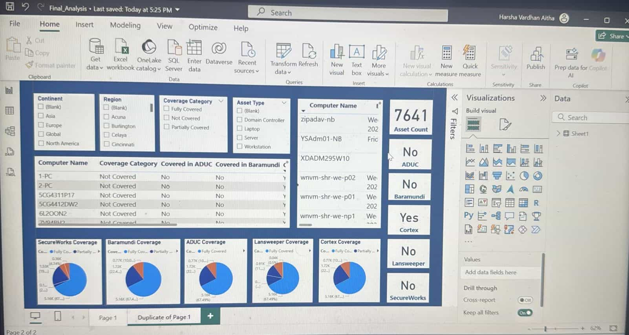

Slide 17
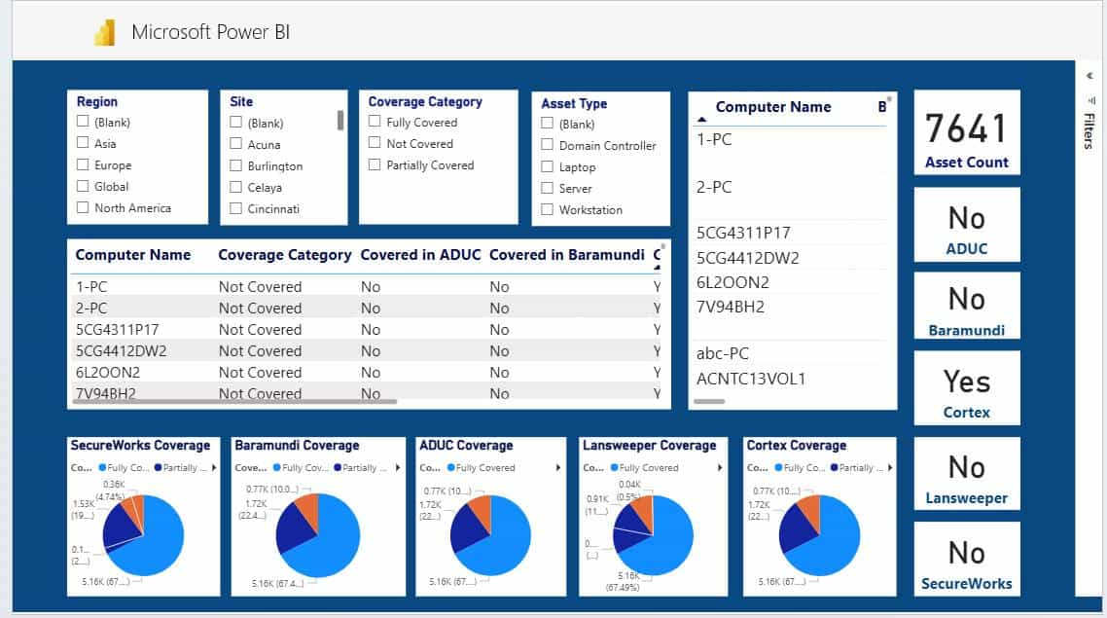

Slide 18



Gap analysis shows varied Visibility % Coverage Across Security Tools
97%
99%
100%
95%
96%
cortex
SECURE works
Tenable
Baramundi
Active
Directory

Slide 19

Project Overview
Technical Details:
Python Web Application
OpenAI chat (like ChatGPT)
Connects with Microsoft Azure services
Azure Synapse Analytics, Azure AI Search,
Fast, inexpensive, and secure
What can it do?
Upload, download, and edit Gentherm internal documents
Use filters/names to find documents, as with a usual browser
Chat with an AI assistant that can interpret your questions to provide relevant documents

Slide 20
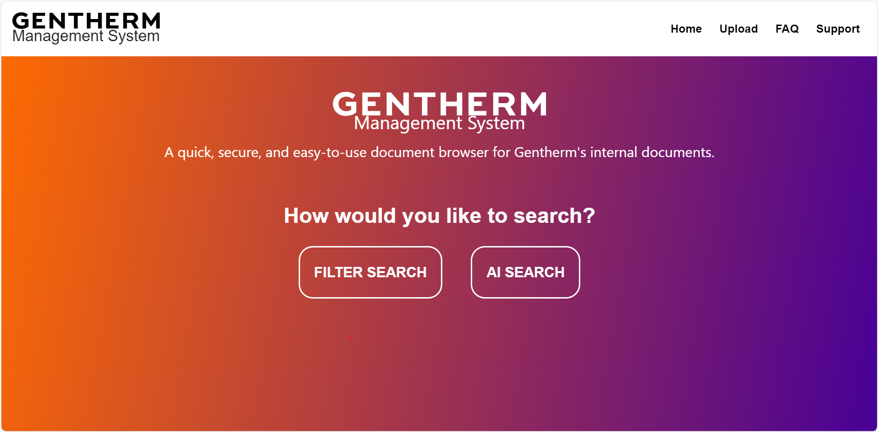
Project Walkthrough

Slide 21
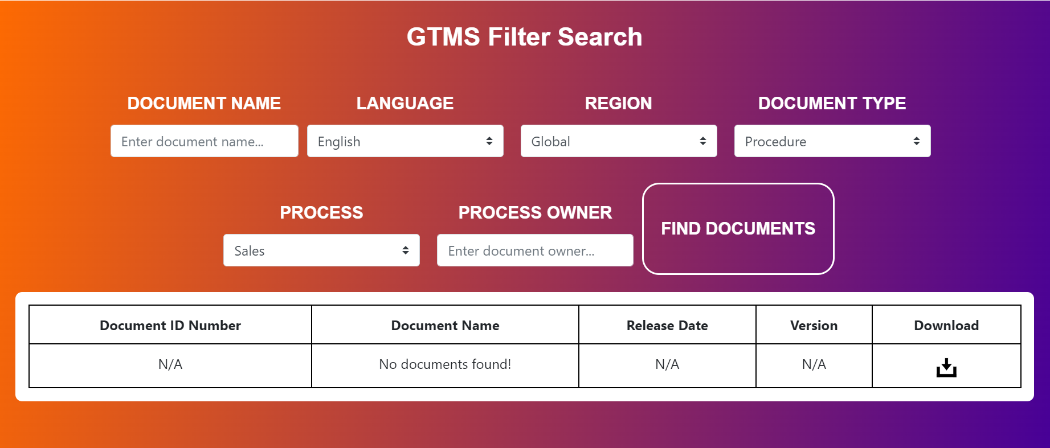
Project Walkthrough
Search for documents by details with filters:

Slide 22
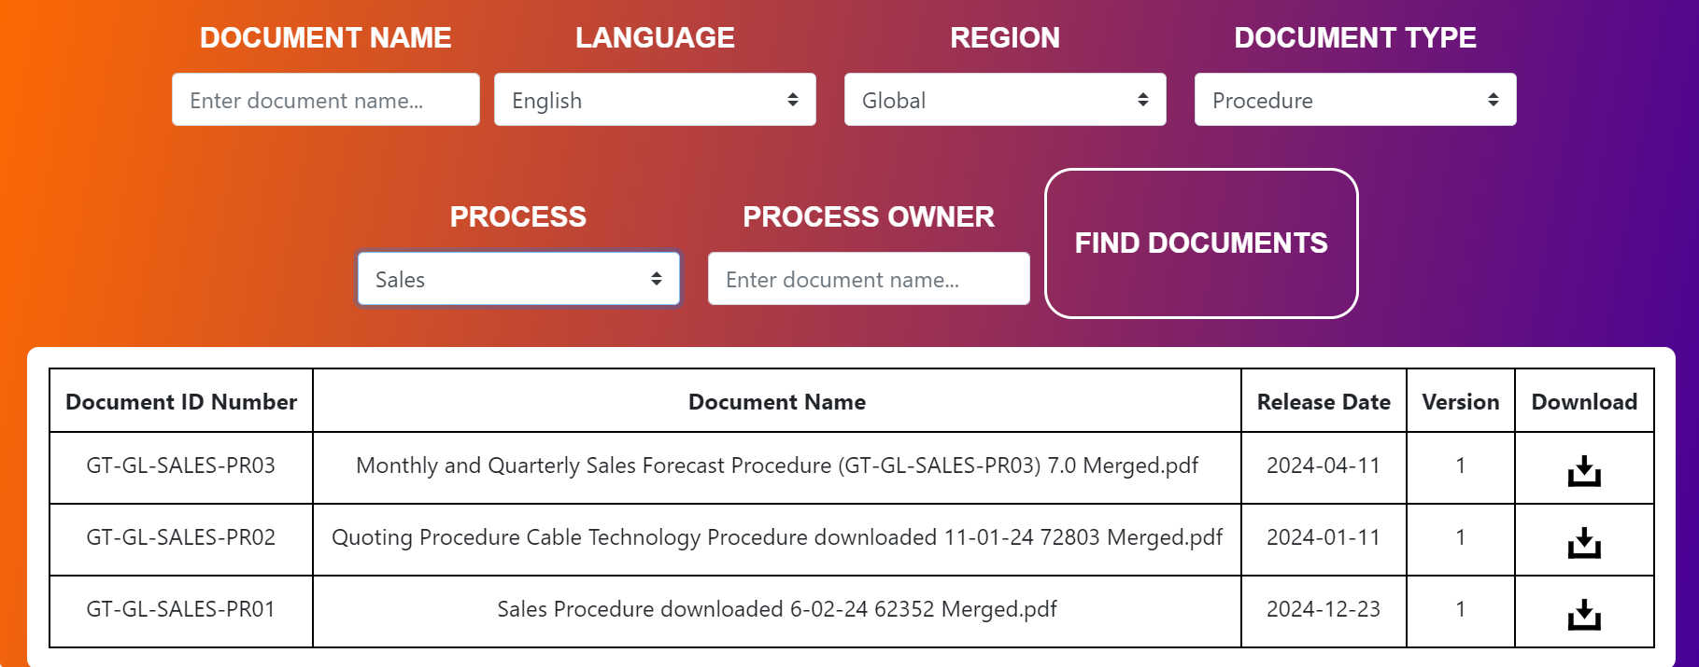

Slide 23
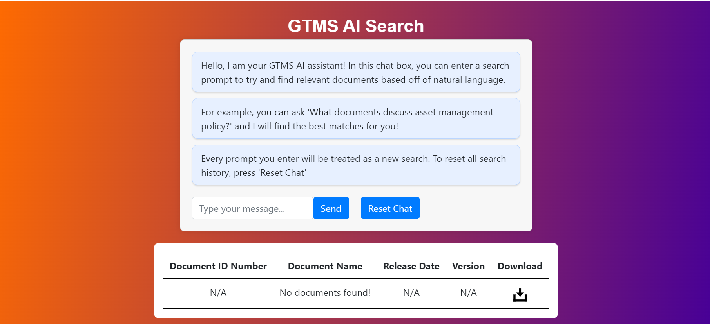
Project Walkthrough
Search for documents with AI:

Slide 24
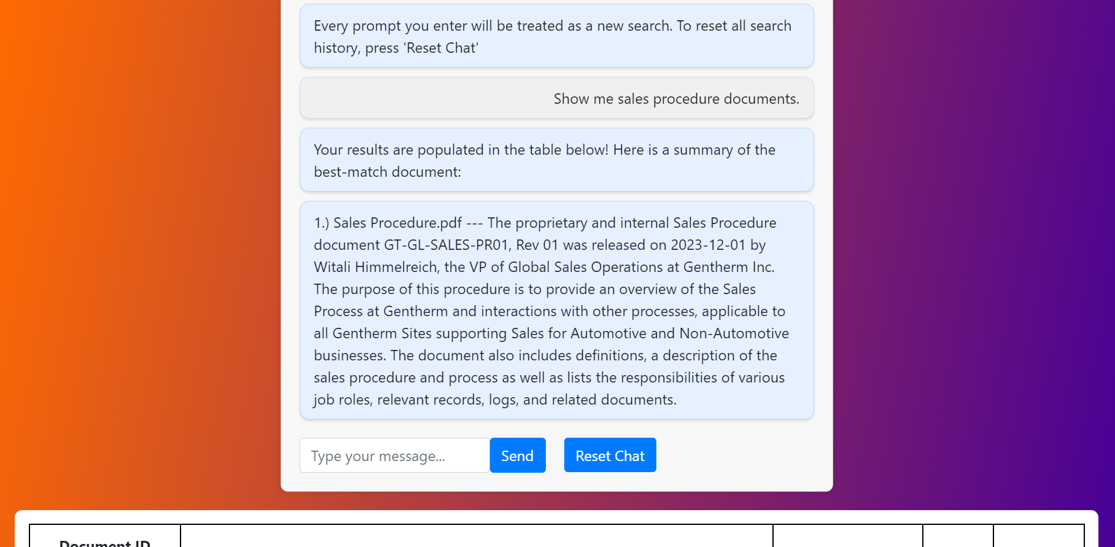

Slide 25
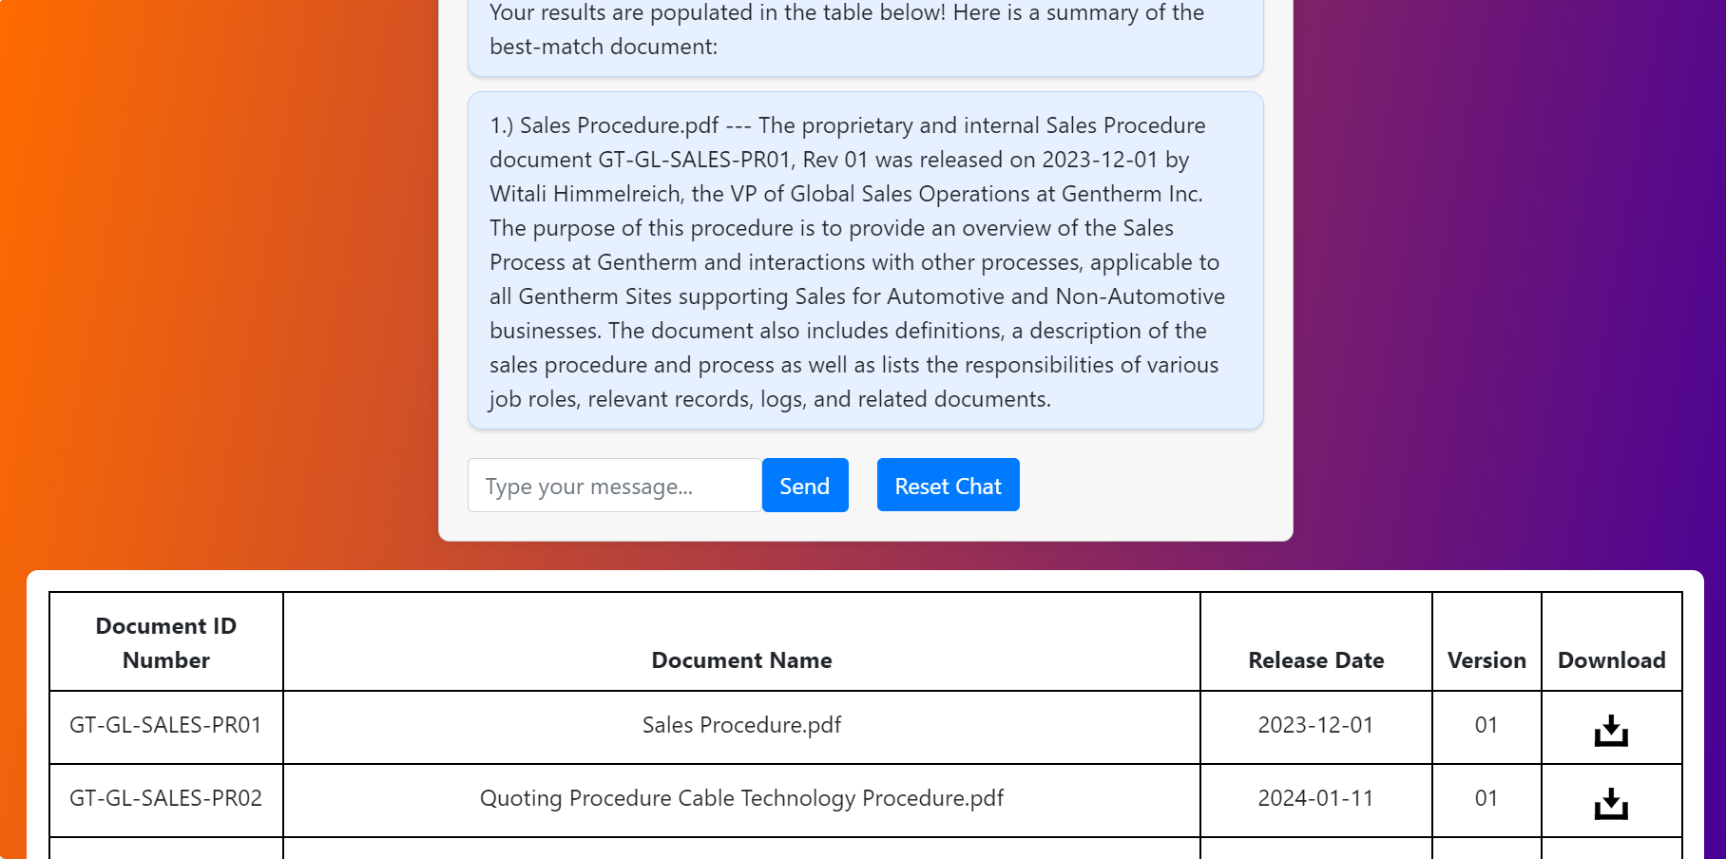

Slide 26



Do you have Any Question?

